Slide 1
Box Office Prediction Using Machine Learning Techniques
Boya yashasvi naidu Abhiram varma
210962070 210962072

Slide 2
CONTIBUTIONS:
Boya Yashasvi Naidu:
Produced the final Methodology
Performed Feature Extraction and Data Exploration
Model development and selection
Analysis of results and further tuning
Report
Abhiram Varma:
Data acquisition and preprocessing
Analysed previous literature and identified the best methods to use for this dataset
Data Exploration
PPT

Slide 3
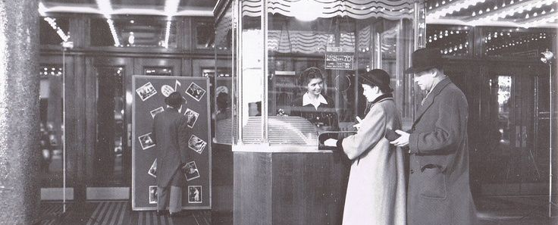
INTRODUCTION:

Slide 4
The film industry's potential for substantial revenue, exemplified by India's 2022 box office revenue of Rs 10,600 crore, attracts significant investments.
Technological advancements provide a wealth of data, yet predicting box office success remains complex as it depends on numerous variables.
This study uses machine learning techniques to predict how much revenue a movie might make.
It's aimed at helping investors and movie companies make better decisions about which movies to produce and invest in and how to plan their production.

Slide 5
Research Gap:
Integration of Diverse Data Sources:
As stated previously, since the box office of a movie is dependent on numerous variables, it becomes tricky to incorporate every variable as they are ever changing and ever evolving
Granular Prediction Models:
Current models primarily forecast overall box office revenue, but there's a gap in predicting specific performance aspects like opening weekend revenue, international box office collections, or DVD/online sales.
Developing granular models that predict these specific revenue streams could provide nuanced insights valuable for film studios and distributors.

Slide 6
Objectives:
Attribute Analysis for Box Office Success:
To analyse correlations between various movie attributes (e.g., release date, director, franchise association) and box office performance metrics.
Identification of Key Predictive Attributes:
Pinpointing key factors which strongly correlated with box office revenue.
Accurate Prediction Models:
The primary goal is to create predictive models or methodologies that accurately forecast box office performance based on intrinsic movie attributes

Slide 7
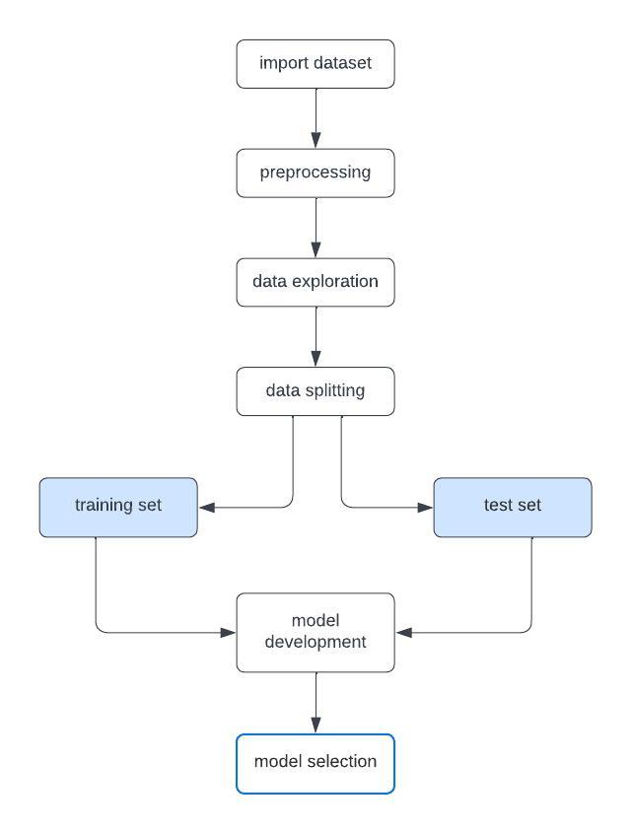
Methodology:
The overall methodology as was followed is shown in the block diagram.
The dataset is first imported
It is then preprocessed as seen fit to be fed into a model
The data is explored to identify the relationships between various attributes.
The models are then trained, and the best performing model is selected.

Slide 8
A. Data Acquisition:
The dataset comprises of details of movies from all around the world while most of the movies are from the U.S. The dataset is acquired from the global TMDB dataset.
3000 movies along with all their features are present
The relevant features included in this study are as follows: “id”, “belongs_to_collection”, “budget”, “genres”, “homepage”, “imdb_id”, “original_language”, “original_title”, “overview”, “popularity”, “poster_path”, “production_companies”, “production_countries”, “release_date”, “runtime”, “spoken_languages”, “status”, “tagline”, “title”, “Keywords”, “cast”, “crew”, “revenue”.

Slide 9
B. Preprocessing and Feature Extraction:
The dataset was updated by filling missing numerical values (like Budget) with their column means, while categorical missing values (like Genre) were replaced with their respective column modes.
It also involved creating collections for unassociated items and splitting the 'release date' feature into separate day, month, and year features after removing NULL entries.
The features Genre, Production companies, Production countries and Languages are encoded.

Slide 10
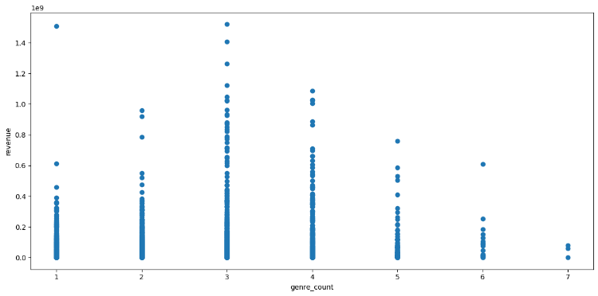
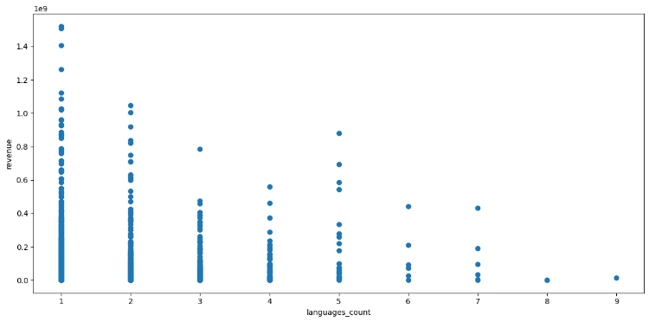
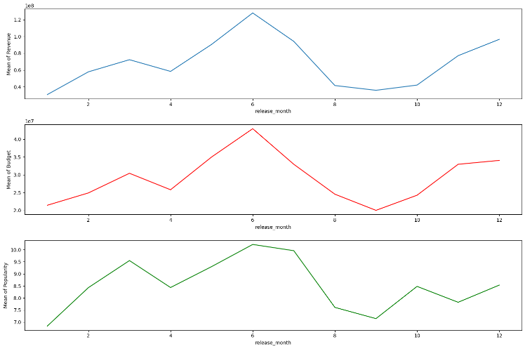
C. Data Exploration:
Movies with 3 genres make the most revenues
Single language films are more likely to make more revenue.
Mean of revenue, budget, popularity peak in the 6th month.

Slide 11
D. Data Splitting:
Divide the pre-processed dataset into training and testing sets using a 70:30 ratio. The training set (70%) will be used for model training, while the testing set (30%) will evaluate model performance.
E. Model Development:
Various models are developed and subsequently, the model with the best performance is chosen.
The models developed are: Linear Regression, KNeighbors Regressor, Decision Tree Regressor, Random Forest Regressor, SVR

Slide 12
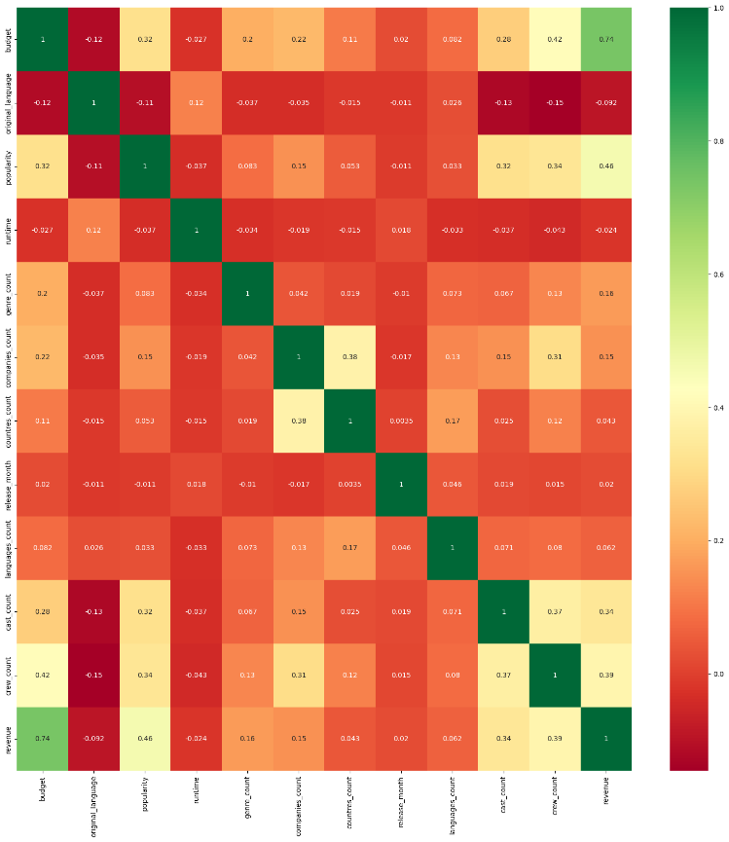
DISCUSSION AND ANALYSIS OF RESULTS:
If in a dataset, multiple attributes are highly correlated with each other, it implies duplication of information, and the subsequently trained model may not perform well.
Hence, highly correlated attributes should be removed.
The threshold taken is 0.7
From the correlation matrix obtained, it can be seen that, none of the attributes are highly correlated to each other (excluding revenue). So, no attribute will be removed.

Slide 13
Parameter Tuning:
Linear Regression benefits from grid search optimization for parameters like normalization, intercept, and regularization strength to enhance predictive accuracy.
KNeighbors Regressor tuning involves finding the right number of neighbours, distance metrics, and weights for bias-variance balance.
In Decision Trees, maximizing depth, minimum samples for splitting contribute to hyperparameter optimization.
Optimizing Random Forest Regressor includes fine-tuning tree numbers, depth for improved accuracy, noting minimal gains in accuracy with varied tree counts.
Support Vector Regression's hyperparameter tuning targets kernel selection, regularization parameter (C), and kernel coefficient (gamma) for capturing complex data relationships, refining prediction accuracy.

Slide 14
CONCLUSION:
The random forest model leads with 68.73% accuracy, showcasing its strength in understanding complex feature relationships and excelling in generalizing to new data.
While other models perform reasonably well, linear regression closely follows at 62.14%, yet none match the random forest's superior performance on this dataset.
Model | Accuracy
Linear Regression | 62.14
KNeighbors Regressor | 59.81
Decision Tree Regressor | 35.62
Random Forest Regressor | 68.73
SVR | -15.48
Table 1: Accuracies of each model

